Slide 1
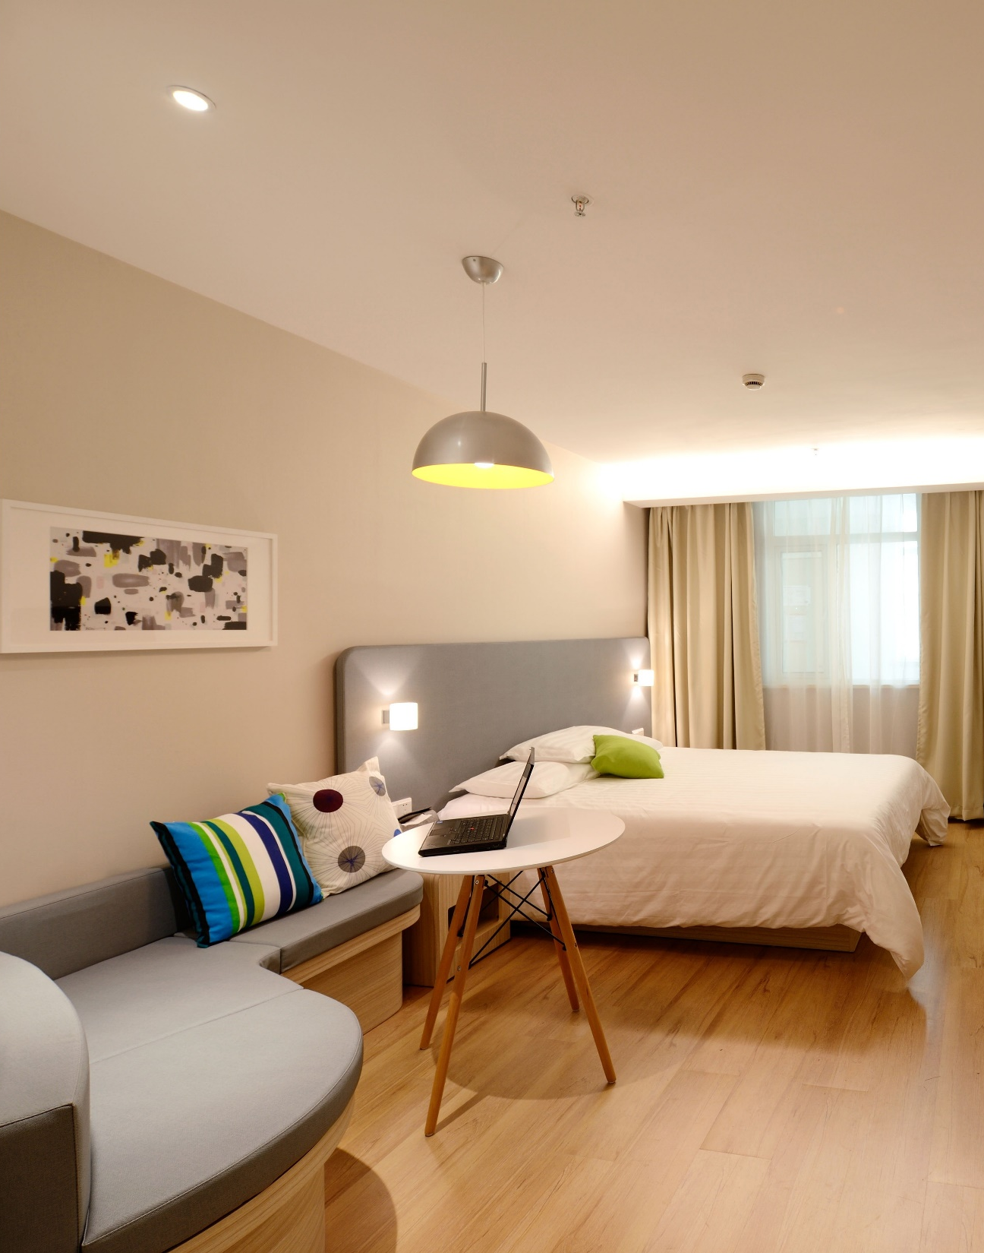

Listings in Singapore
By: Cicilia Parastita Ningrum

Slide 2


MILESTONE 1

Slide 3
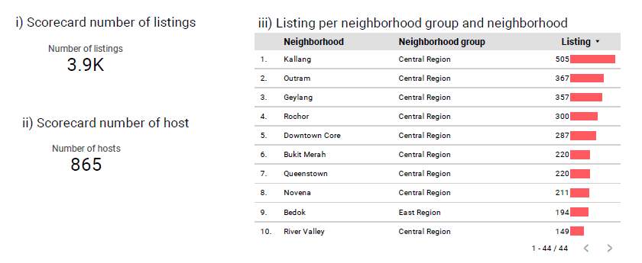
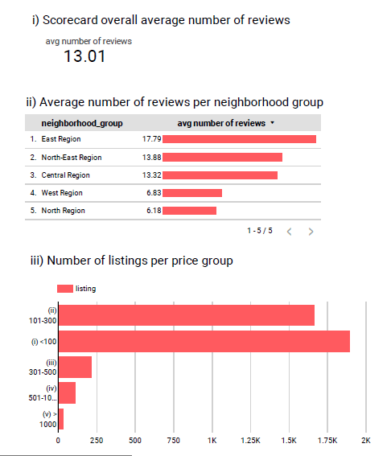
Problem
Scorecard number of listings
Scorecard number of hosts
Scorecard overall average number of reviews

Slide 4
Number of listing per neighborhood group and neighborhood

Slide 5
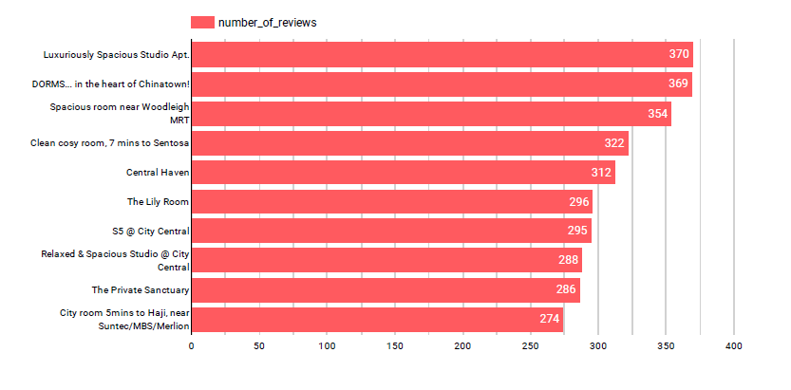
Top 10 listings based on total review given

Slide 6
Average number of reviews per neighborhood group
Number of listing per price group

Slide 7
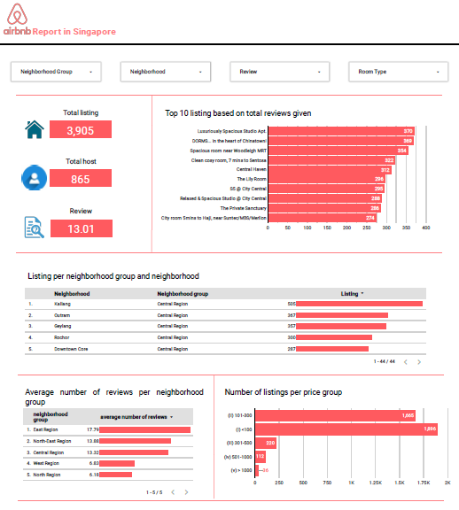
Link: https://datastudio.google.com/reporting/48546584-d02e-494f-a0a3-387631a37df7

